Slide 1
Modeling Urban Stormwater Using EPA-SWMM
Robert (Bob) Carr, PE, CSM, ENV_SP
Water Resources Modeling, LLC
Robert Dickinson, ME
Innovyze
Austin, TX
January 31 – February 1, 2010
Thanks to David Sample, Ph.D for slide information.

Slide 2
WORKSHOP GOAL
To provide professionals in the stormwater management field with a detailed understanding of the hydrologic/hydraulic modeling tools in EPASWMM available to support design of practices intended to control and mitigate the negative effects of urban runoff.

Slide 3
Day 1:
Surface runoff hydrology o Introduction to GUI features and Theory o Runoff and Infiltration Options o SCS methodology
Hydraulic routing o Introduction to GUI features and Theory o Pipe and surface channel modeling o Hydraulic routing using kinematic and dynamic wave algorithms
Advanced Hydrology o Importing hydrographs generated from other models (application) o SCS Hydrographs (supplied by NCIMM as Time Series) o Low Impact Development (LID) stormwater modeling
Advanced Hydraulic o HEC-RAS Natural Sections o Quasi Flood Plain Modeling o Real Time Controls
Detention basin modeling o Ponds o Weirs o Orifices

Slide 4
Day 2:
Understanding the precision and accuracy of SWMM modeling (presentation from detailed studies of SWMM modeling)
Individualized instruction on specific SWMM modeling capabilities o “Dual-drainage” systems using surface streets as conveyance o Natural Channels o Surface Ponding or Quasi 2D Modeling o Low Impact Development (LID) stormwater modeling o Stormwater quality modeling

Slide 5
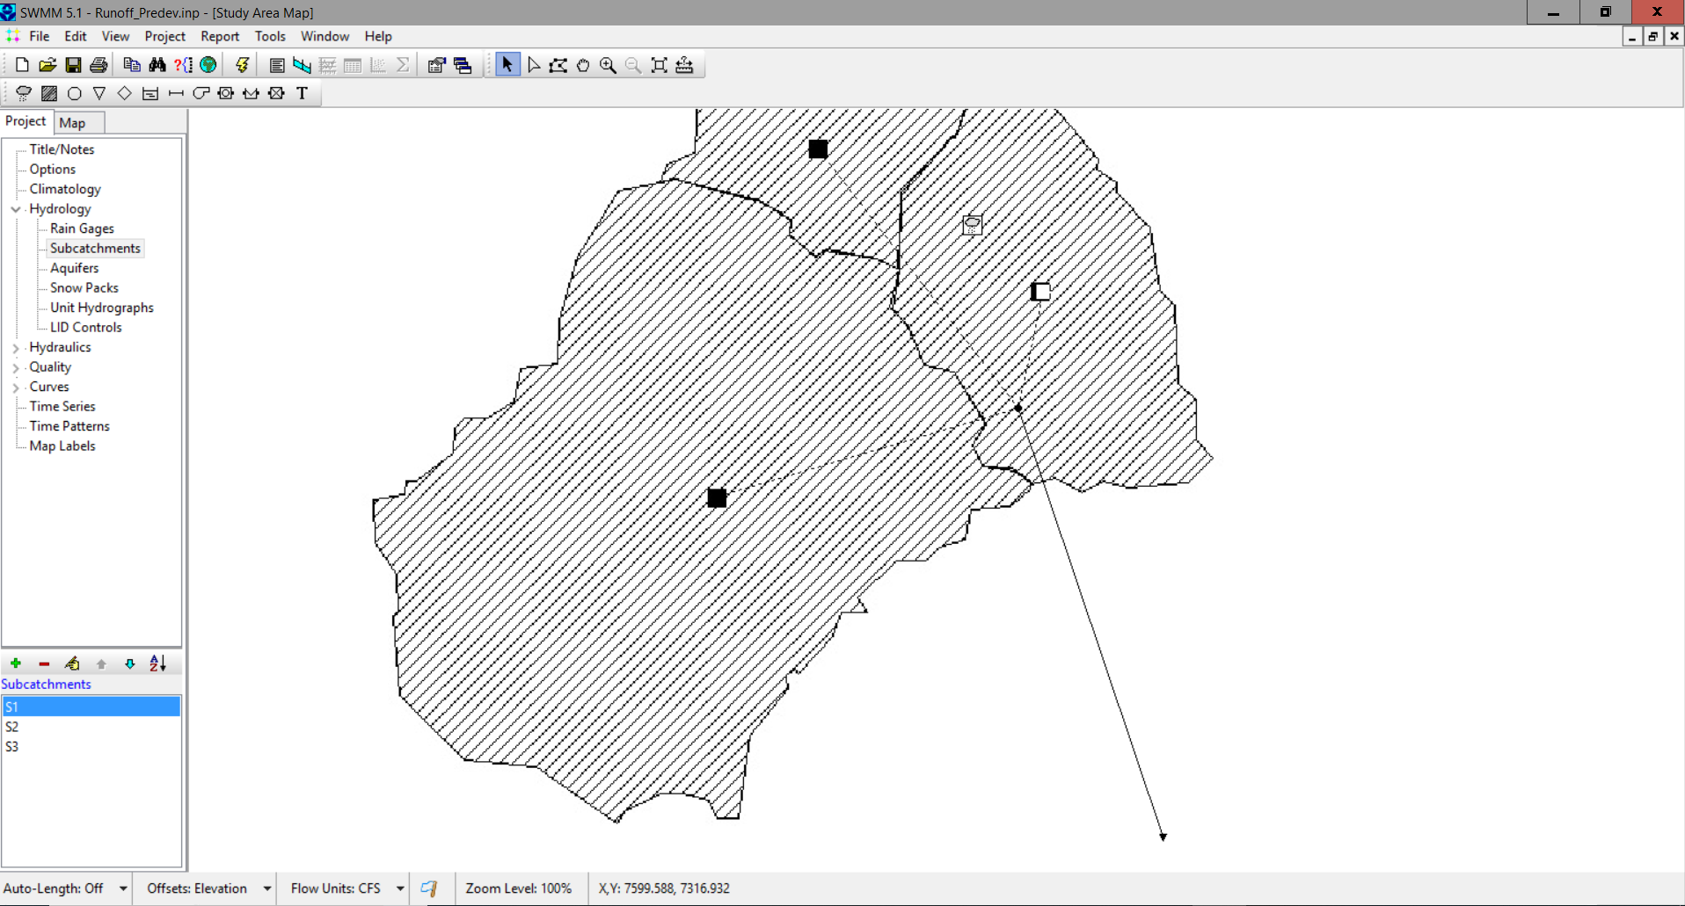
SWMM Model
1-dimensional, hydrologic model
Lumped parameter (as opposed to distributed)
Link-node architecture

Slide 6
SWMM History
Based upon information from James, W., Rossman, L.A., Huber, W.C., Dickinson, R.E., James, R.C., Roesner, L.A., and Aldrich, J.A., 2005, User’s Guide to SWMM5, Computational Hydraulics International, Ltd, 852 pages.

Slide 7
SWMM History (Con’t)
Based upon information from James, W., Rossman, L.A., Huber, W.C., Dickinson, R.E., James, R.C., Roesner, L.A., and Aldrich, J.A., 2005, User’s Guide to SWMM5, Computational Hydraulics International, Ltd, 852 pages.

Slide 8
SWMM Runoff
CONCEPT:
Developed by the USA EPA as a deterministic approach to runoff
Data Needs
Drainage Area
Percent Impervious
Basin Slope and Width
Rainfall
Evaporation
Infiltration Method
Limitations
Lumped Catchment Parameters

Slide 9
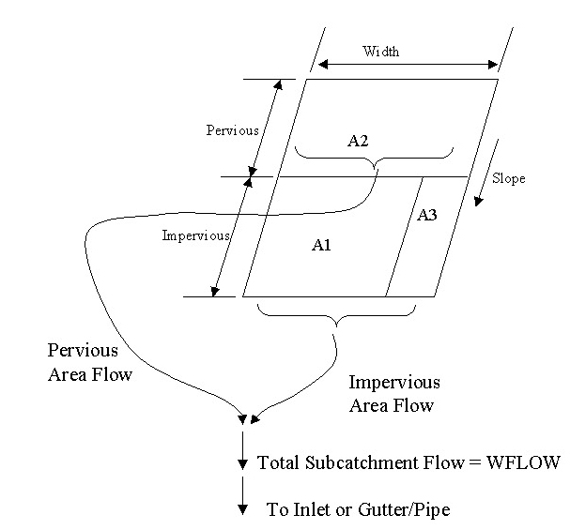
Subcatchments
Idealized rectangular catchment
Routing choices
Pervious (adjacent sub- catchment)
Impervious (adjacent sub- catchment)
Outlet
James, W., Rossman, L.A., Huber, W.C., Dickinson, R.E., James, R.C., Roesner, L.A., and Aldrich, J.A., 2005, User’s Guide to SWMM5, Computational Hydraulics International, Ltd, 852 pages.

Slide 10
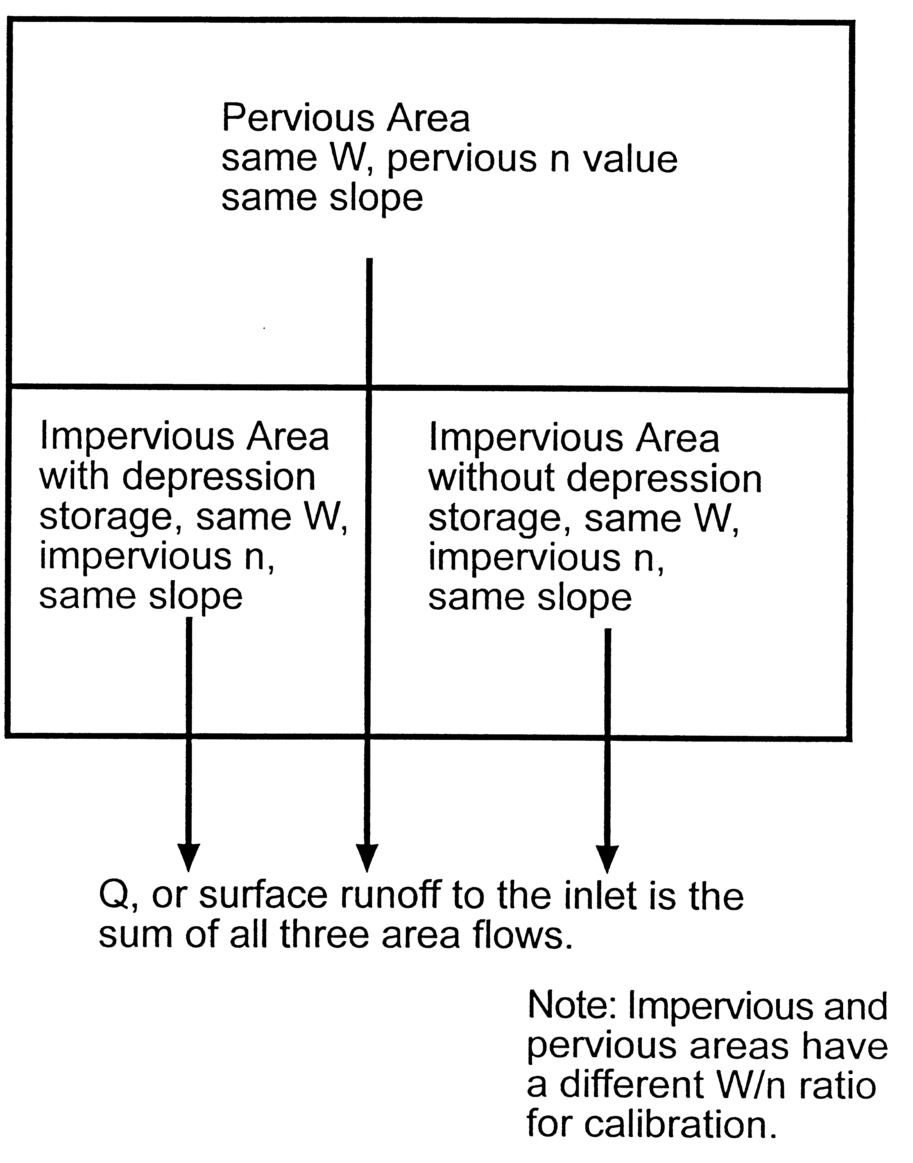
Catchment Surfaces

Slide 11
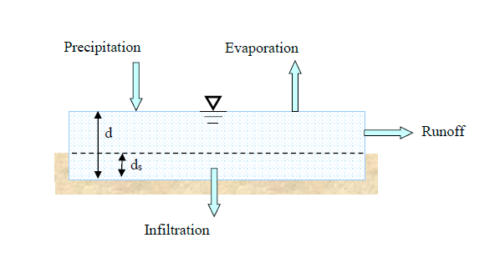


Runoff Routing from Catchments
Non-linear Reservoir Model
(coupled equations)
Continuity:
Where:
V = A · d = volume of water on the subarea, [L³]
d = water depth, [L]
t = time, [T]
A = surface area of subcatchment, [L²]
i* = rainfall excess = rainfall/snowmelt intensity minus evaporation, [L/T]
Q = subcatchment (or subarea) outflow, [L³/T]
$$\frac{dV}{dt}=A\frac{dd}{dt}=A−i^{∗}−Q$$
Manning’s Equation (omit 1.49 for SI):
n = Manning's roughness coefficient,
d = water depth, [L]
d_{p} = depth of depression (retention) storage, [L]
S = slope, dimensionless
$$Q=W∙\frac{1.49}{n}{\left(d−d_{p}\right) }^{5/3}S^{1/2}$$
Source: Rossman, L., 2016. Storm Water Management Model Reference Manual Volume I – Hydrology, U.S. Environmental Protection Agency, National Risk Management Research Laboratory, Office of Research and Development, 235 p., EPA/600/R-15/162.

Slide 12


Solving Non-linear Reservoir
Solve in each time step
Used in all calculations (omit 1.49 for SI)
$$\frac{d_{2}−d_{1}}{∆t}=i^{∗}+WCON∙{\left[d_{1}+\frac{1}{2}\left(d_{2}−d_{1}\right)−d_{p}\right]}^{5/3}$$
$$WCON=\frac{1.49∙W{∙S}^{1/2}}{A∙n}$$
James, W., Rossman, L.A., Huber, W.C., Dickinson, R.E., James, R.C., Roesner, L.A., and Aldrich, J.A., 2005, User’s Guide to SWMM5, Computational Hydraulics International, Ltd, 852 pages.

Slide 13
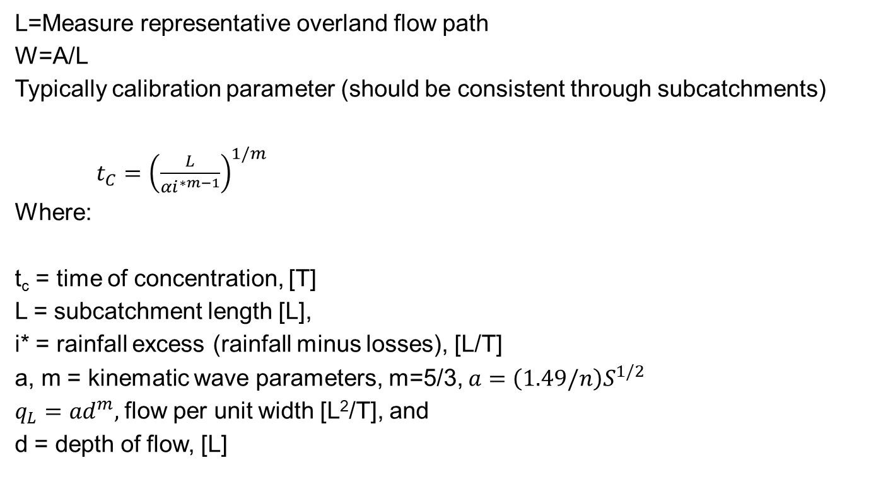
What is Subcatchment Width?
L=Measure representative overland flow path
W=A/L
Typically calibration parameter (should be consistent through subcatchments)
$t_{C}={\left(\frac{L}{αi^{∗m−1}}\right)}^{1/m}$
Where:
t_{c} = time of concentration, [T]
L = subcatchment length [L],
i* = rainfall excess (rainfall minus losses), [L/T]
a, m = kinematic wave parameters, m=5/3, $a=\left(1.49/n\right)S^{1/2}$
$q_{L}=ad^{m},$flow per unit width [L²/T], and
d = depth of flow, [L]
James, W., Rossman, L.A., Huber, W.C., Dickinson, R.E., James, R.C., Roesner, L.A., and Aldrich, J.A., 2005, User’s Guide to SWMM5, Computational Hydraulics International, Ltd, 852 pages.

Slide 14
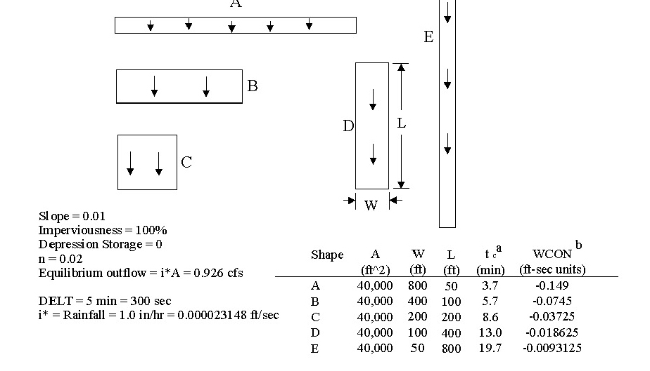
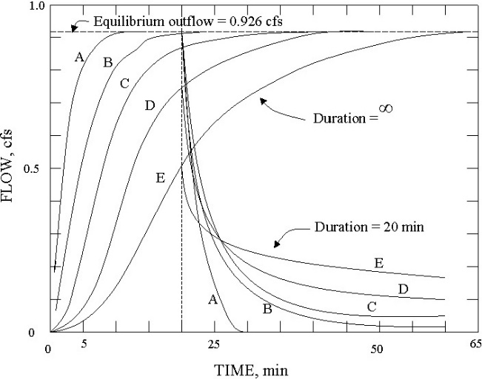
Hydraulic Width Effects
James, W., Rossman, L.A., Huber, W.C., Dickinson, R.E., James, R.C., Roesner, L.A., and Aldrich, J.A., 2005, User’s Guide to SWMM5, Computational Hydraulics International, Ltd, 852 pages.

Slide 15
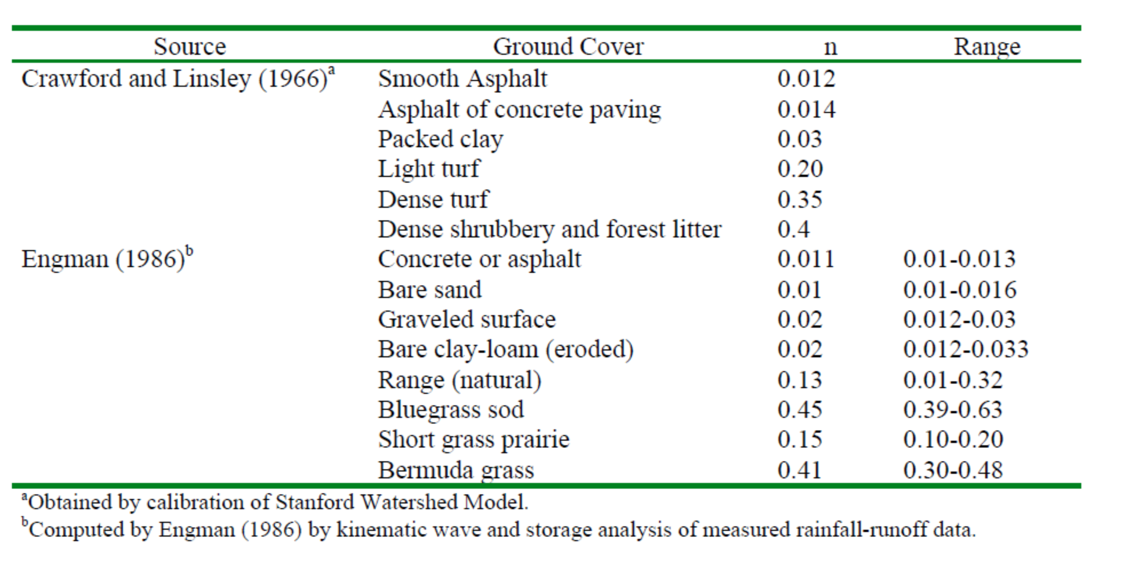
Overland Flow Roughness
Similar to channels, but different
James, W., Rossman, L.A., Huber, W.C., Dickinson, R.E., James, R.C., Roesner, L.A., and Aldrich, J.A., 2005, User’s Guide to SWMM5, Computational Hydraulics International, Ltd, 852 pages.

Slide 16
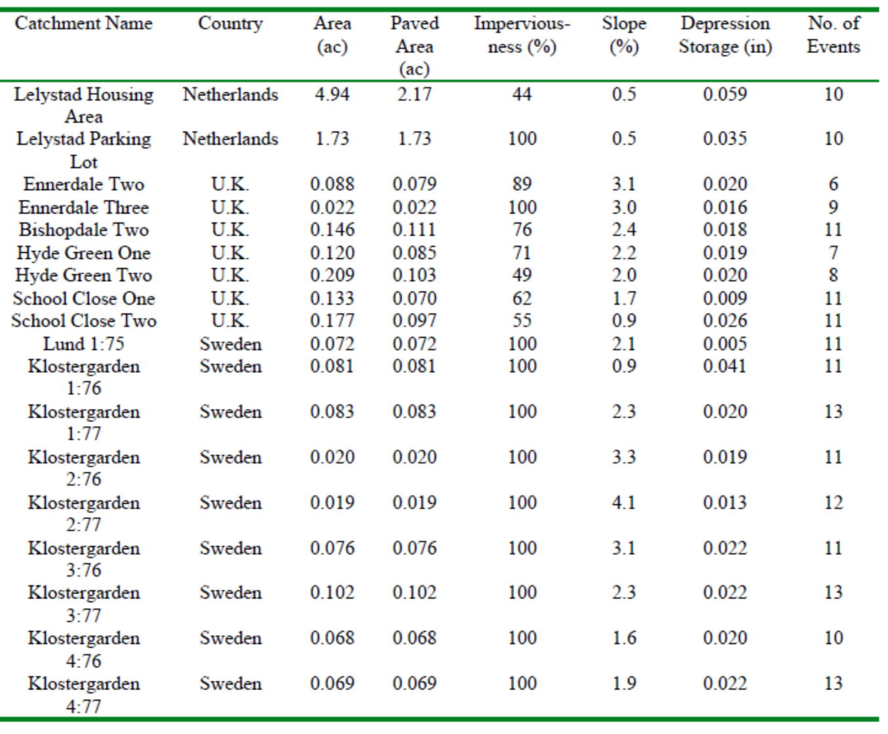
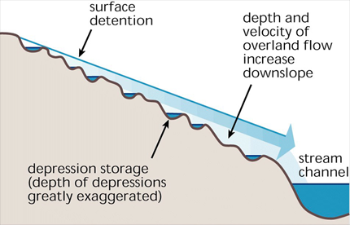
Depression Storage
Measure of surface storage in uneven depressions
Subject to calibration
James, W., Rossman, L.A., Huber, W.C., Dickinson, R.E., James, R.C., Roesner, L.A., and Aldrich, J.A., 2005, User’s Guide to SWMM5, Computational Hydraulics International, Ltd, 852 pages.

Slide 17
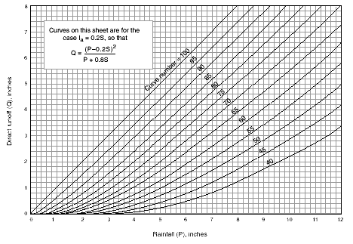
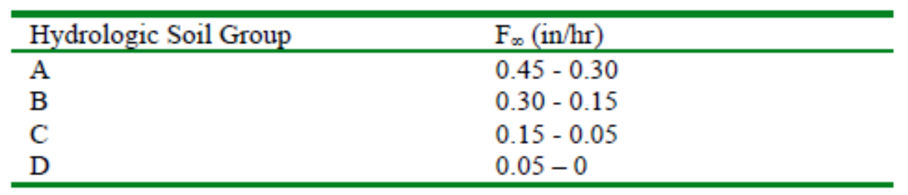
Infiltration
SCS
P = rainfall, [L]
S = storage after runoff begins, [L]
I_{a} = initial abstraction=0.2S, [L]
Q = runoff volume @ depth, [L]
Horton
fc = infiltration capacity at time t, [L/t]
k = constant relating the rate of decreasing infiltration capacity, [T⁻¹]
f_{c} = final or equilibrium infiltration capacity, [L/T]
f₀ = initial infiltration capacity, [L/T]
James, W., Rossman, L.A., Huber, W.C., Dickinson, R.E., James, R.C., Roesner, L.A., and Aldrich, J.A., 2005, User’s Guide to SWMM5, Computational Hydraulics International, Ltd, 852 pages.

Slide 18
Infiltration
Green-Ampt
F (t) = accumulated infiltration during time step t, [L]
f (t) = infiltration rate during time step t, [L/T]
K = saturated hydraulic conductivity of layer, [L/TT]
Δθ = η- θ_{i} , change in moisture
θ_{i} =Soil moisture content
η = porosity
Ѱ = Soil suction head, [L]
Note: IMD lower for single event
Sample, D. and Heaney, J., 2006. Integrated Management of Irrigation and Urban Stormwater Infiltration, J. Water Res. Pl. ASCE, 132 (5): 362-373. 132 (5), 362-373, Available from: http://link.aip.org/link/?QWR/132/362/1.

Slide 19
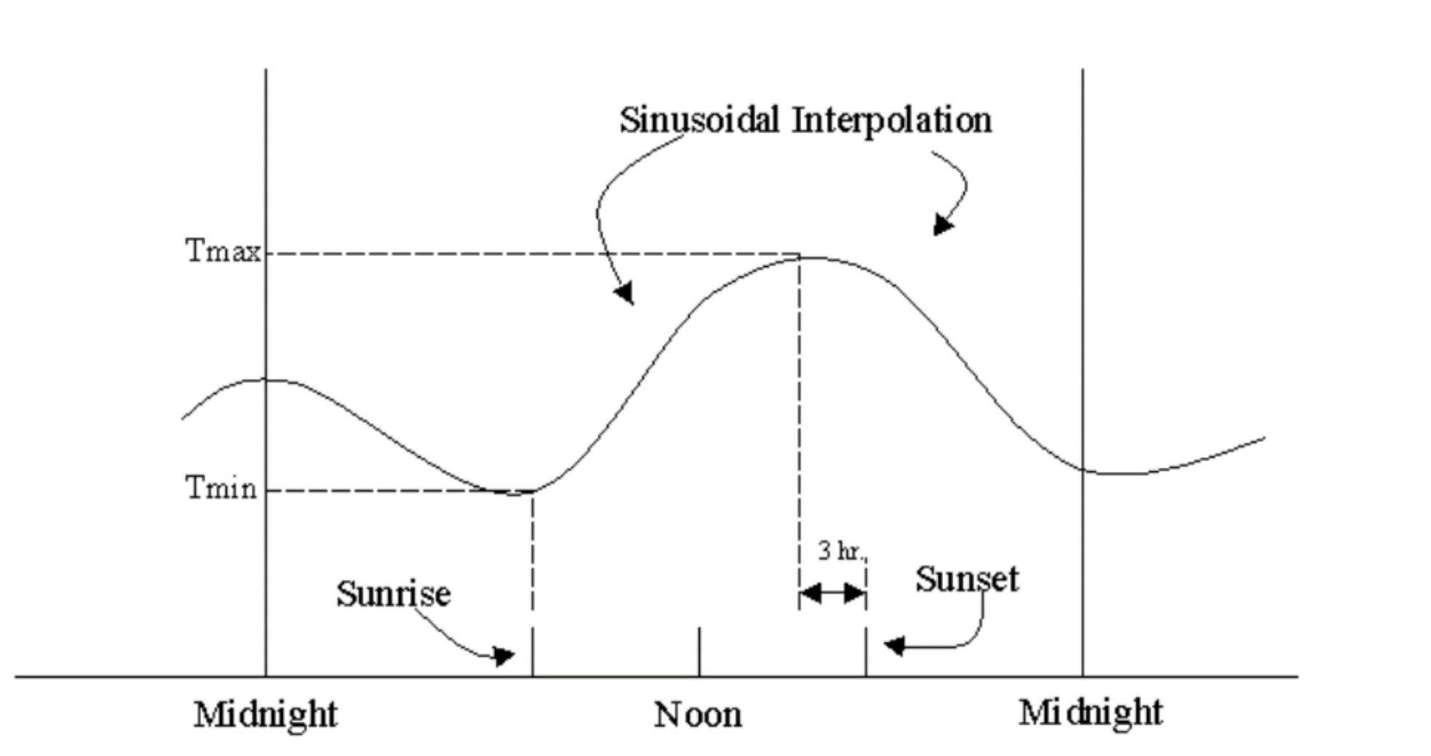
Evaporation
Climatology, daily, max, min T
James, W., Rossman, L.A., Huber, W.C., Dickinson, R.E., James, R.C., Roesner, L.A., and Aldrich, J.A., 2005, User’s Guide to SWMM5, Computational Hydraulics International, Ltd, 852 pages.

Slide 20
Soil Moisture Storage
ΔS = change in soil moisture storage P = precipitation, [L]
R = runoff volume, [L]
ET = evapotranspiration, [L]
Wilting Point
Field Capacity
Depletion
Regeneration
Sample, D. and Heaney, J., 2006. Integrated Management of Irrigation and Urban Stormwater Infiltration, J. Water Res. Pl. ASCE, 132 (5): 362-373. 132 (5), 362-373, Available from: http://link.aip.org/link/?QWR/132/362/1.

Slide 21
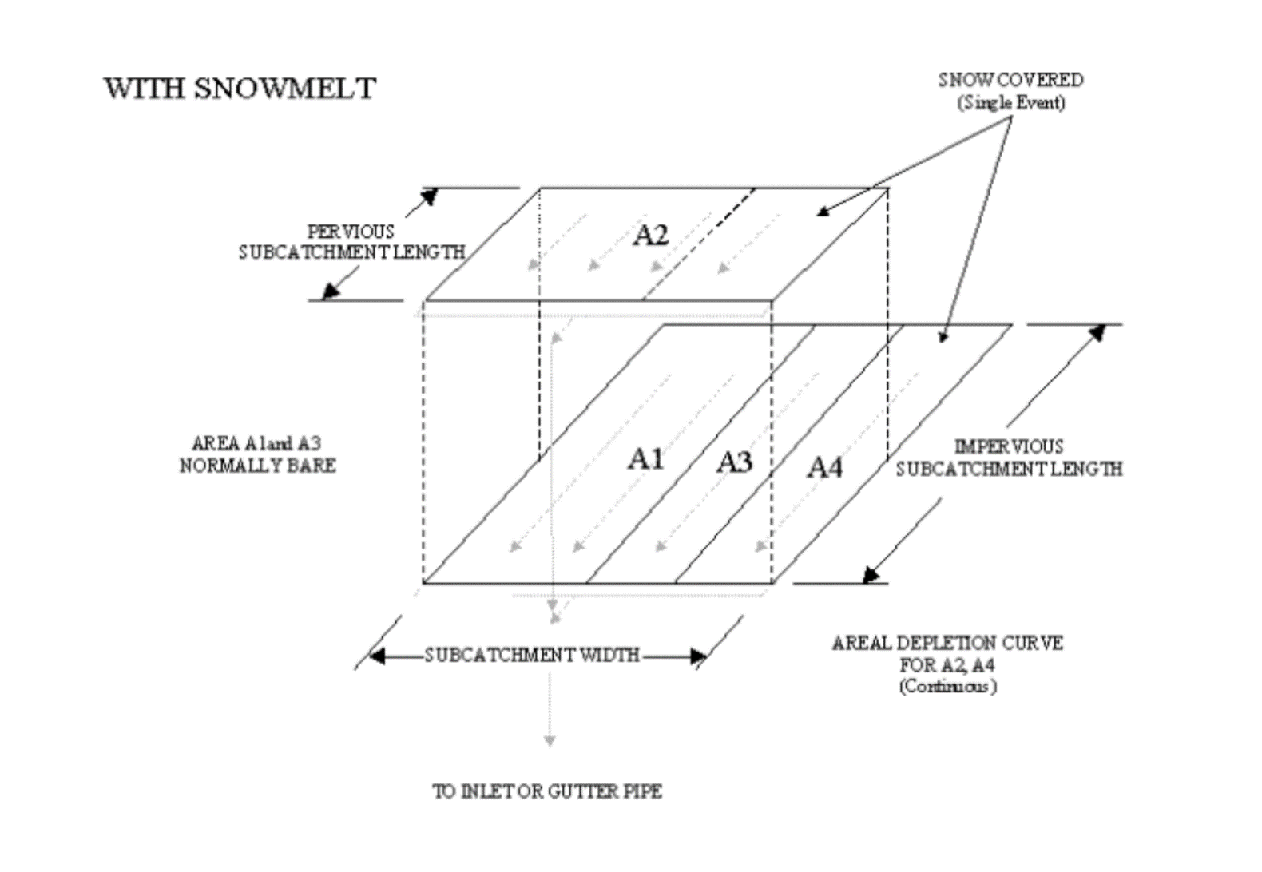
Snowmelt
Accumulation
Melting
Removal
Sample, D. and Heaney, J., 2006. Integrated Management of Irrigation and Urban Stormwater Infiltration, J. Water Res. Pl. ASCE, 132 (5): 362-373. 132 (5), 362-373, Available from: http://link.aip.org/link/?QWR/132/362/1.

Slide 22
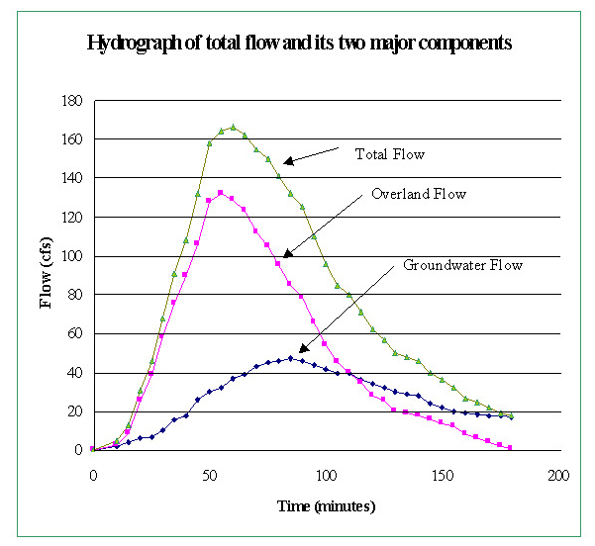
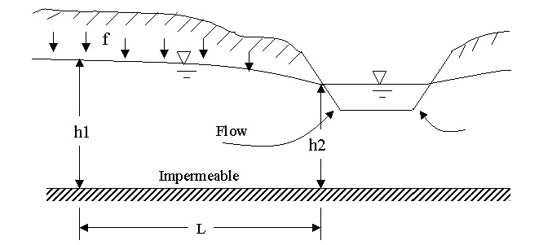
Groundwater
Provides a sink for deep percolation
Necessary for continuous simulation
James, W., Rossman, L.A., Huber, W.C., Dickinson, R.E., James, R.C., Roesner, L.A., and Aldrich, J.A., 2005, User’s Guide to SWMM5, Computational Hydraulics International, Ltd, 852 pages.

Slide 23
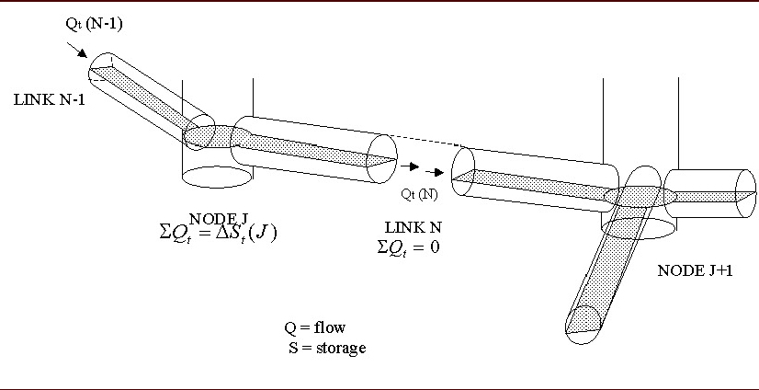
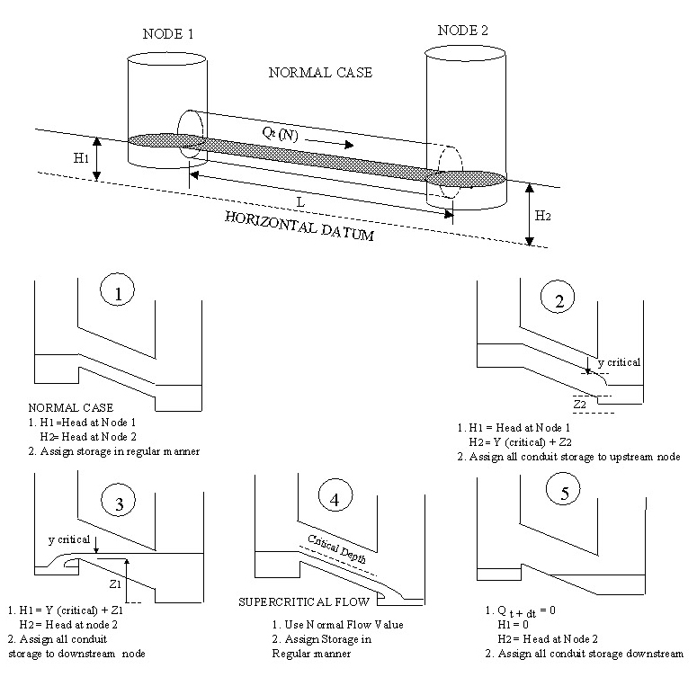
Junctions and Conduits
James, W., Rossman, L.A., Huber, W.C., Dickinson, R.E., James, R.C., Roesner, L.A., and Aldrich, J.A., 2005, User’s Guide to SWMM5, Computational Hydraulics International, Ltd, 852 pages.

Slide 24
BMP Modeling
Wet/dry Ponds, are modeled as storage nodes
LID BMPs are embedded in subcatchments
Types:
Bioretention/Rain garden
Green roof
Infiltration trench
Permeable pavement
Rain barrels
Vegetated swales
Types
Routing: Pervious:Pervious
Outflow: Normally to pipe
LID Practice
Subcatchment

Slide 25
SWMM LID Limitations
BMPs are modeled within subcatchments, not nodes
Routing-pervious to pervious issues
Treatment simplified, mass balance
Infiltration approximation during wetting/drying
Subcatchment 1
LID Practice 1
LID Practice 2
Subcatchment 1a
Subcatchment 2a

Slide 26
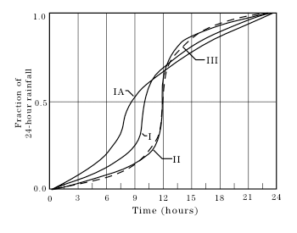
Event-Based Simulation
Event-based
Uses SCS Type I, IA, II, III rainfall, 24 hours, or real short-duration storm events, including NOAA A-D
Multiply Weighting factor by storm volume, found at: http://dipper.nws.noaa.gov/hdsc/pfds
Typically ignore:
Evapotranspiration
Groundwater
Long term soil moisture (but initial conditions are important
Typically uncalibrated

Slide 27
Continuous Simulation
Purpose, to review long term trends and system behavior in terms of occurrence frequencies
Requires:
Hourly or subhourly (15-minute) rainfall, normally for 10 years or more (NWS)
Climatological data (temperature) for ET simulation (NWS)
http://gis.ncdc.noaa.gov/map/viewer/#app=cdo
http://cdo.ncdc.noaa.gov/qclcd/QCLCD?prior=N
Can use National Stormwater Calculator
Development of Aquifer storage/groundwater flow
Calibration: normally done if data available

Slide 28
Applications of SWMM
Designing drainage system components for flood control.
Design of detention facilities for flood control and water quality.
Mapping flood plains of natural channels (SWMM 5 is a FEMA-approved model for NFIP studies).
Designing control strategies for minimizing combined sewer overflows.

Slide 29
Applications of SWMM (con’t)
Evaluating the impact of inflow and infiltration on sanitary sewer overflows (SSOs).
Generating non-point source pollutant loadings for waste load allocation studies.
Controlling site runoff using low impact development (LID) or green infrastructure (GI).
Evaluating the effectiveness of BMPs for reducing wet weather pollutant loadings.

